Slide 1
Super Sensors Ad-hoc network
Wireless and mobile communications
Jay Lohokare Revati Damle

Slide 2

Sensors

Slide 3
Sensors
Smarter devices – More sensors
Detecting motion, temperature, interactions, light, pressure, state (On/Off), speed, etc
Sensors are essential to enable intelligent control and detect events for monitoring
Remote control and detection is possible only due to sensors in the appliances
Every ‘smart’ appliance today has its own set of sensors
Together these sensors can predict the events happening in a room/place – Mixer turned on, Refrigerator door
opened, tap turned on, fan turned on etc
Do we really need so many sensors?

Slide 4
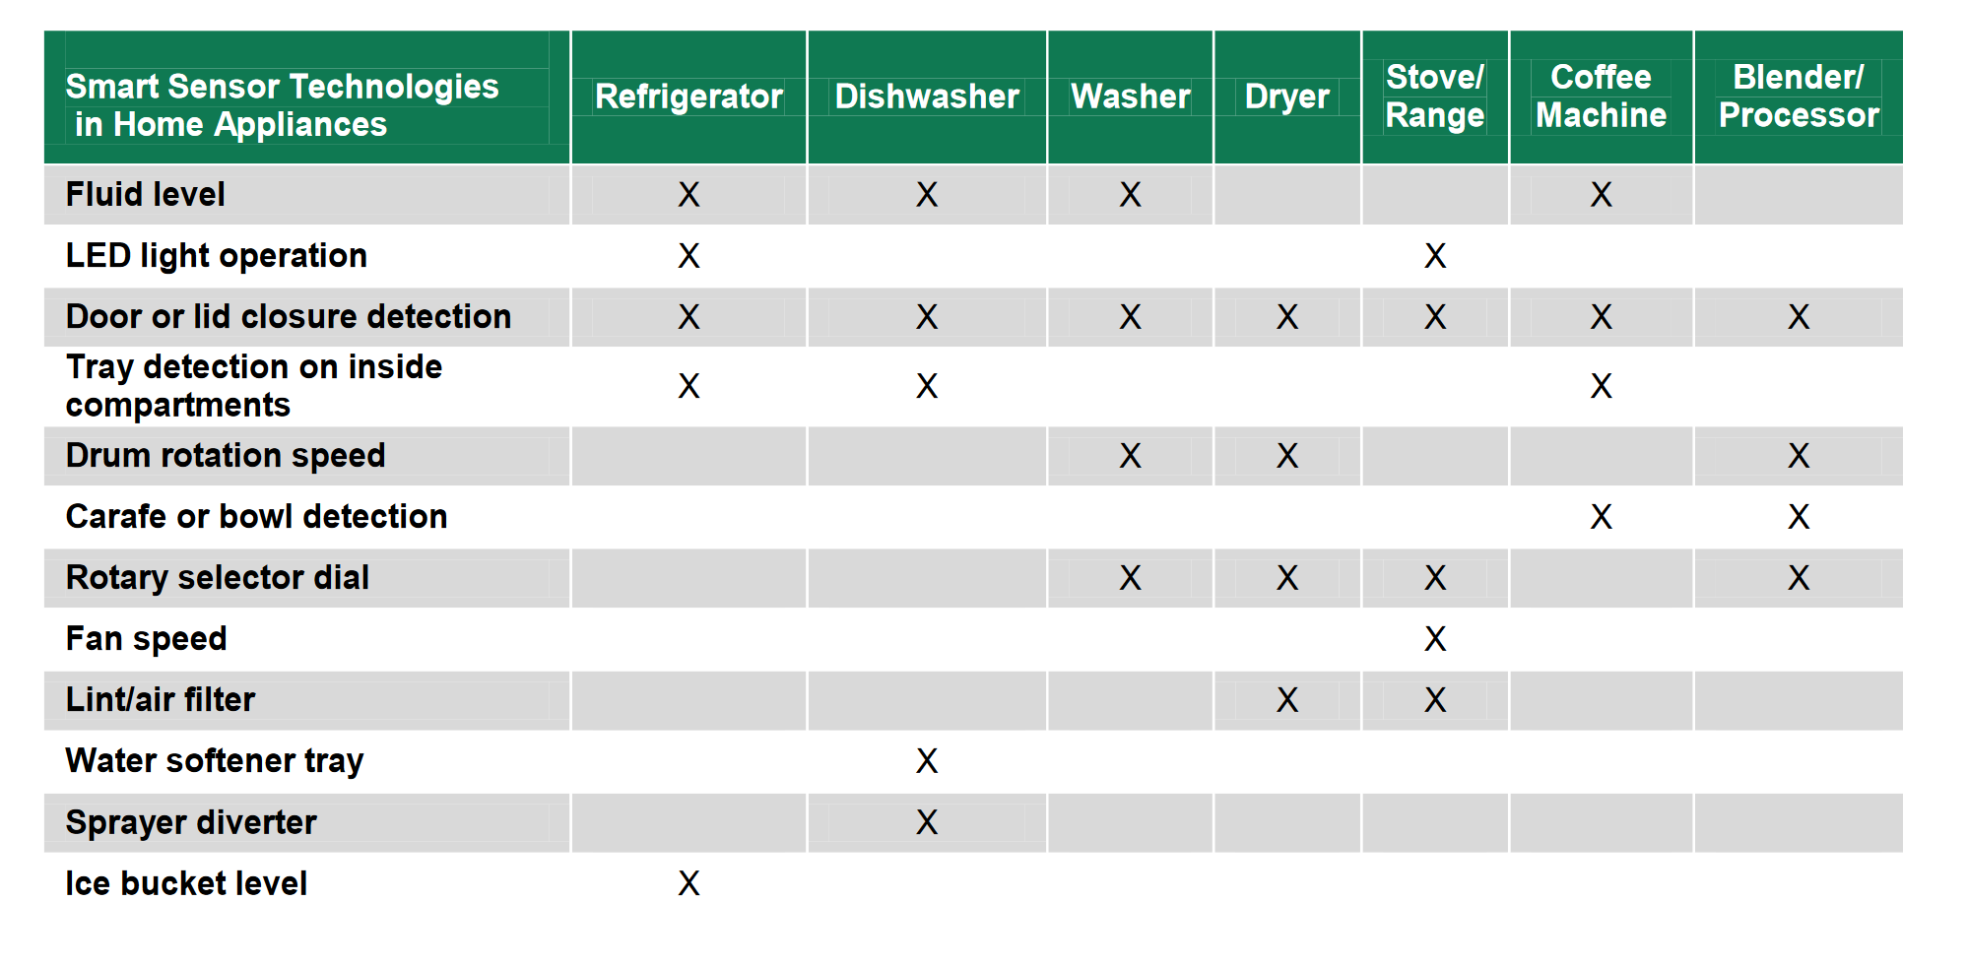

Slide 5
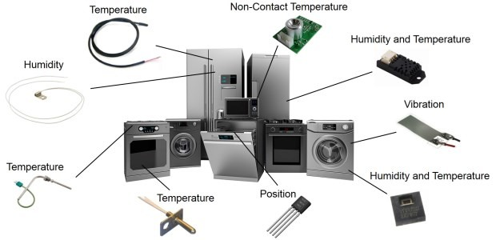

Slide 6

‘Super sensor’

Slide 7
Super sensors
All the sensors in a room are sensing the same characteristics – Device states
Why not use one sensing module to detect it all?
Machine learning could be used to create a ‘Super sensing’ module to detect any event
No need of having redundant sensors in multiple appliances
Super sensor detects it all – Microwave, Food mixer, Refrigerator, Taps, Lights, Fans, AC, Washing Machine, etc
How can we achieve this ?

Slide 8



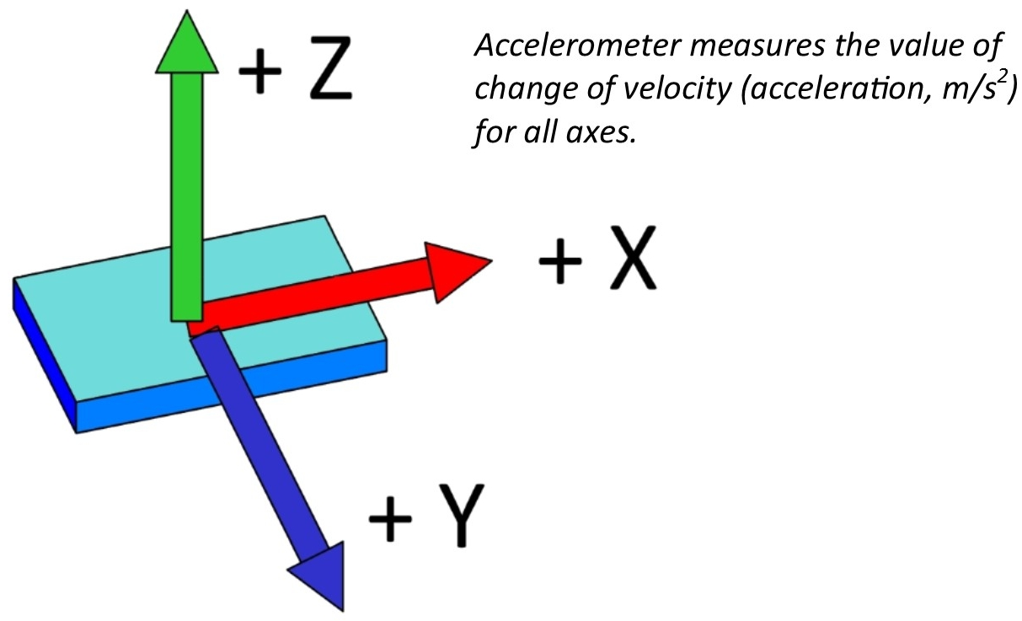
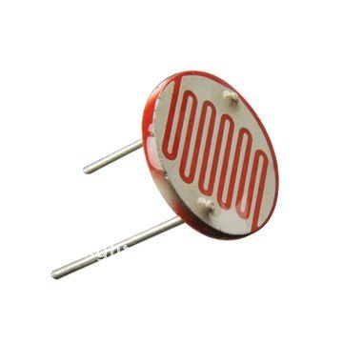
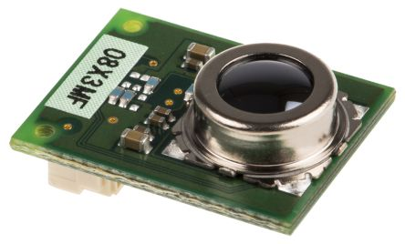
Super sensor
Super Sensor unit
Temperature
Mic
Magnetometer
Accelerometer
Thermal sensor
Light sensor

Slide 9
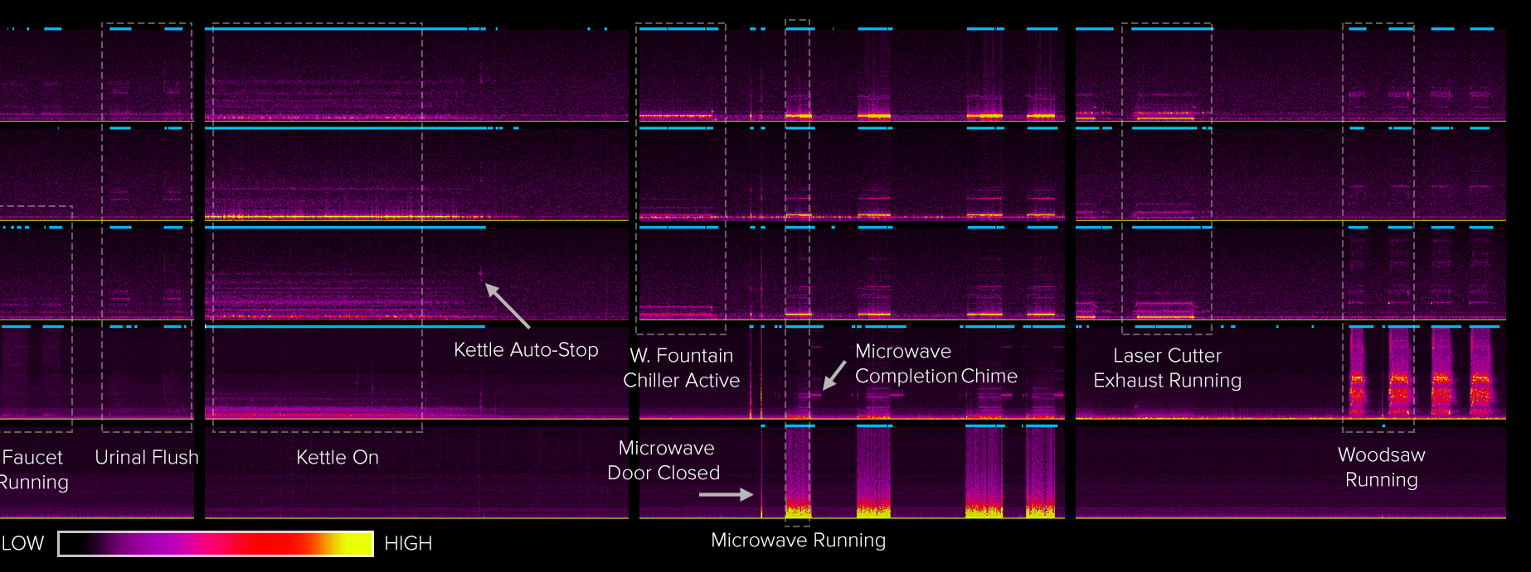
Working of a Super sensor

Slide 10


Super sensor construction
Super sensors can be built using any low-cost processing platforms (Example – RaspberryPi), ESP8266
1. Capturing data events to train – Run scripts to capture sensor data for various events
2. TensorFlow – train a machine learning model to predict events based on the input data
3. Transfer the model ‘.pb’ file to the hardware to enable detection.
What did we build -
We used Android to capture the data (Mic and Magnetometer)
We trained for 2 events – Microwave turned on, Tap water turned on (Obtained prediction accuracy of 76%)
We put this model on Android to build an application that detects tap water and microwave events!

Slide 11
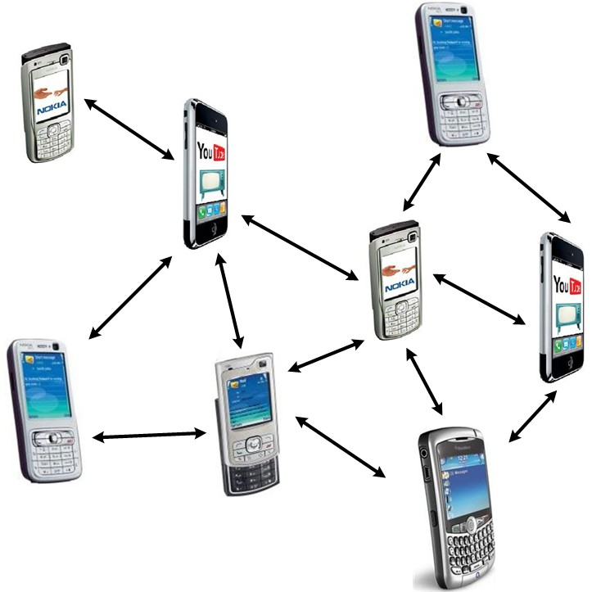
Ad-hoc networks

Slide 12
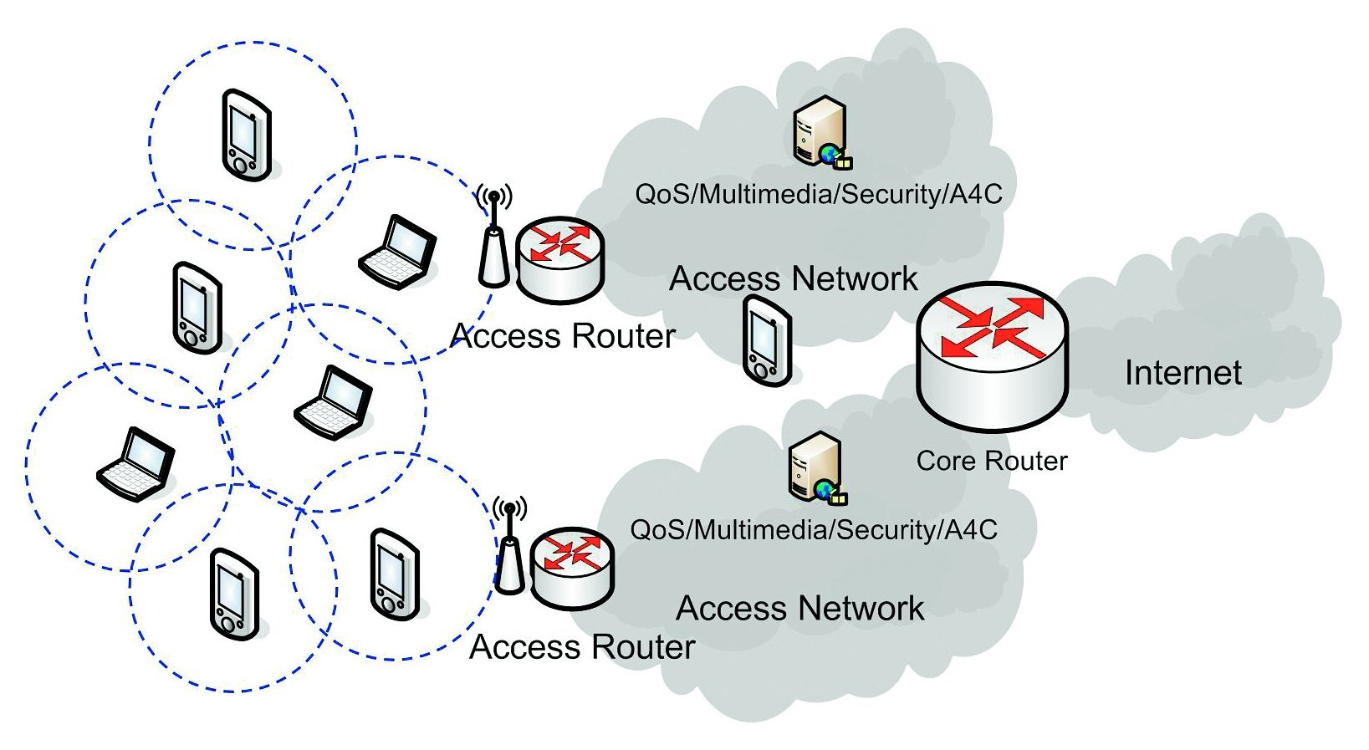
Ad-hoc Networks
Router independent
Peer to Peer data transfer
Routing tables keep updating on demand
‘AODV’ – Ad hoc On-Demand Distance Vector

Slide 13
Why Ad-hoc sensor network?
Adding/Removing new nodes becomes easy
No need to configure/setup the internet settings
Simply add new nodes as more range needed
Ad-hoc networks allow mobility – Sensors need not stay at same place
Better power consumption
Sensor ad-hoc networks have proven to be better than traditional network settings – Added mobility,
Independence from infrastructure, easy add new node

Slide 14
AODV over Bluetooth beacons
‘Super sensors’ over Bluetooth could implement AODV
Android Things + Android supports Beacons (ALTBeacon library)
Pseudo AODV using JSONs to transfer data over BLE
Implemented features –
TTL
Source + Destination address
On Demand routing update
Google Nearby API – Adhoc network over BLE, Wifi, Ultrasound
BLE Beacon Advertisement – Discovery of nearby devices
Advertisements could broadcast data packets to all nearby devices over BLE
On the receivers end, check:
Hop count
Destination address
All the data packets will ultimately reach the controller node
All events in the network will thus be detected by the ‘Central Hub’

Slide 15
Overall architecture:
Node
Node
Node
Controller Hub
Node
Node
Node
Node

Slide 16
How AODV over BLE works
Not all devices are directly connected to the hub
But a devices will find path for data to the central hub via its peers
AODV ensures no data packet loss if there is a path between node and hub
The Controller hub can be internet connected to send data to web/applications, to allow remote monitoring
The network topology is dynamic, any nodes can be added/deleted at any time
There needs to be another node in range of a node for data transfer to be possible

